Slide 1
FABRIC PROPERTY AND DEFECT DETECTION USING DEEP LEARNING
GUIDED BY
Mrs. Rajeswari D
Assistant professor
Department of CSE
PRESENTED BY
Kumuthini M (19051UEO18)
Shre Subasine J(19098UEO32)
Veenaloshini U(19126UEO46)

Slide 2
OVERVIEW
LITERATURE SURVEY
PROBLEM STATEMENTS
OBJECTIVES
INTRODUCTION
PROPOSED SYSTEM
BLOCK DIAGRAM
TECHNICAL SPECIFICATIONS
METHODOLOGY
MODULUE
CONCLUSION AND FUTURE WORK
REFERENCE
PUBLICATIONS

Slide 3
LITERATURE SURVEY
S.NO | PAPER | AUTHOR AND YEAR | METHOD USED | REMARKS
1. | Complex Pattern Jacquard Fabrics Defect Detection Using Convolutional Neural Networks and Multispectral Imaging | AUTHORS : Mahmoud M. Khodier,Sabah M. Ahmed,Mohammed Sharaf Sayed YEAR : 2022 | CNN,Multi spectral imaging | Normal image is converted in to spectral images for training and testing using convoltional neural network for specified future extraction
2. | Unsupervised UNet for Fabric Defect Detection | AUTHORS : Kuan-Hsien Liu,Song-Jie Chen,Tsung-Jung Liu YEAR : 2022 | Unet,CNN | Segmentation process is done for deeper classification using Unet
3. | Image Blind Denoising With Generative Adversarial Network Based Noise Modeling | AUTHORS : J. Chen, J. Chen, H. Chao, M. Yang YEAR : 2018 | Computer Vision and Pattern Recognition | Huge dataset used for training which produces accurate results

Slide 4
LITERATURE SURVEY(CONTD…)
S.NO | PAPER | AUTHOR AND YEAR | METHOD USED | REMARKS
4. | Fabric defect detection with LBP-GLMC(Local binary pattern) | AUTHORS : Kaynar, Yunus Emre, Ferhan Demirkoparan, YEAR : 2017 | Local binary pattern and gray level co-occurrence matrix feature extraction methods and ANN | Defect is classified by analyzing shades by converting the color image to gray scale
5. | Pattern extraction from northern Thai fabrics using flexibly matching segments: Sarong Teenjok and Lanna textiles | AUTHORS : Nattha Vasantapan,Varin Chouvatut YEAR : 2017 | Naïve bayes classifier KNN algorithm | Patterns are classified and pronounced in the specific language
6. | Fabric defect detection methods for circular knitting machines | AUTHORS : Nattha Vasantapan,Varin Chouvatut YEAR : 2017 | Wavelet transform, co-occurrence matrix and CoHOG | Multiple algorithms are involved for accurate classification

Slide 5
PROBLEM STATEMENTS
Diagnosis of texture in a human vision system is easily feasible but in the machine vision domain and image processing have their own complexity.
Manually recognizing cloth pattern and color is more complicated and time consuming for individual human eyes.

Slide 6
OBJECTIVES
To collect different fabric patterns and defects dataset then train the dataset using Deep Learning Model.
To classify the patterns and defects for given inputs and detect the selected region of colors precisely.

Slide 7
INTRODUCTION
Machine Learning (ML) is the area of computational science that focuses on analyzing and interpreting patterns and structures in data to enable learning, reasoning, and decision making outside of human interaction.
Approaches based on early machine learning algorithms directly depend on hand crafted features, which are time-consuming and error-prone processes. Hence, an automated system is needed for classification of woven fabric to improve productivity.

Slide 8
PROPOSED SYSTEM
It is implemented using Deep Learning Convolution Neural Network algorithm to train and classify the fabric patterns and defects.
It uses OpenCV frame work with RGB color pallet dataset to detect the fabric colors precisely.

Slide 9
BLOCK DIAGRAM
DATASET
DATASET
DATA PREPROCESSING
DATASET
CONVOLUTION LAYERS
HIDDEN LAYERS
INPUT IMAGE
IDENTIFYING DEFECTS/PATTERNS/COLORS
TESTING MODE SELECTION
MODEL FILE
CLASSIFIED OUTPUT OF FABRIC

Slide 10
TECHNICAL SPECIFICATIONS
SOFTWARE REQUIREMENTS
Frameworks | OPEN CV, Tensorflow, Keras, Pandas
Python | Version 3.7
Minimum RAM | 4GB
Minimum Processor | Core I3
Operating System | Linux ,Windows
8/16/2023
10

Slide 11
METHODOLOGY
The train data is used for training and it is classified into groups. Test data is used for testing which detects the pattern and defect.
The user can pin point the area of particular region in the image to detect the exact color which is analysed by using Open CV.

Slide 12
MODULE DESCRIPTION
Module 1: DATASET PRE-PROCESSING
In data pre-processing the enhancing and resizing of images is done through Gray scale conversion and histogram equalization, the dataset images are individually varied from their size so to train, the data image resizing is mandatory.

Slide 13
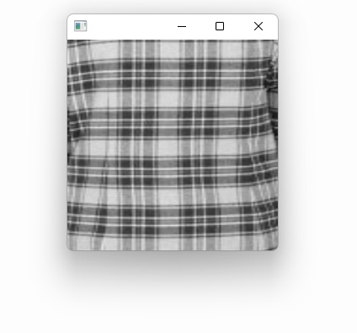
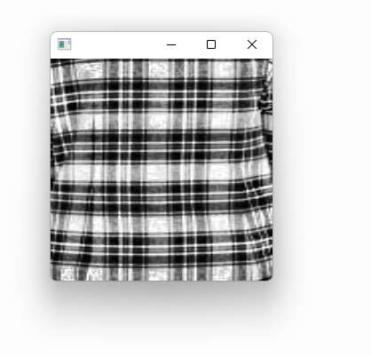
Pre processed image after using enhancing techniques
PROCESSING OF IMAGE
Normal image

Slide 14
MODULE DESCRIPTION (CONTD…)
Module 2: TRAINING AND TESTING PROCESS OF CONVOLUTIONAL NEURAL NETWORK
The training and testing process of CNN has several steps
Step 1: Upload Dataset
Open the image file. The format of the file can be JPEG, PNG, BMP, etc.
Resize the image to match the input size for the Input layer of the Deep Learning model.
Convert the image pixels to float datatype.

Slide 15
MODULE DESCRIPTION(CONTD…)
Step 2: Image at input layer
The input layer is the input of the whole CNN. In the neural network of image processing, it generally represents the pixel matrix of the image.
Step 3: Image processing in Convolutional layer
The convolutional layer is used to extract image features. Low-level convolutional layer extracts shallow features (such as edges, lines, and corners). High-level convolutional layer further learns abstract features through the input of low-level features.

Slide 16
MODULE DESCRIPTION(CONTD…)
Step 4: Next to Pooling layer
A Pooling layer is added after the Convolutional layer(s), as seen in the structure of a CNN above. It down samples the output of the Convolutional layers by sliding the filter of some size with some stride size and calculating the maximum or average of the input.
Step 5: Finally at Dense layer
Dense layer is the regular deeply connected neural network layer. It is most common and frequently used layer. Dense layer does the below operation on the input and return the output.

Slide 17
MODULE DESCRIPTION(CONTD…)
MODULE 3: TEST IMAGE CLASSIFICATION
After training the trained model is saved to the local directory for further process it get formatted into (.model) or (.h5py) extension using this model and the test image is classified .
The main usage is its built-in convolutional layer reduces the high dimensionality of images without losing its information.

Slide 18
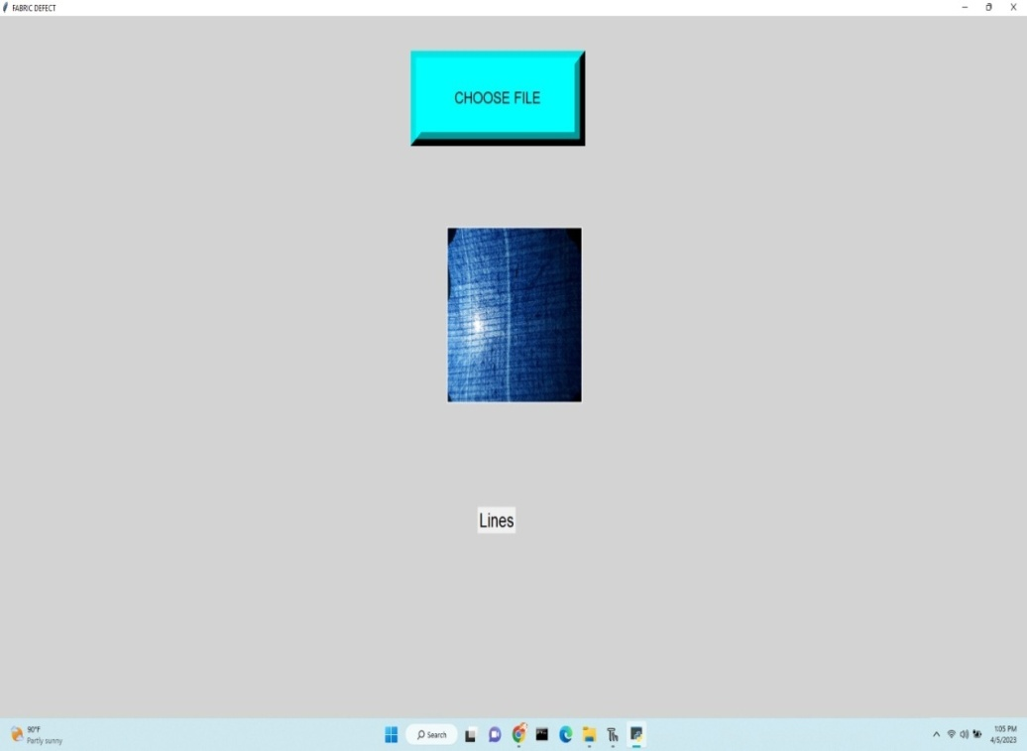
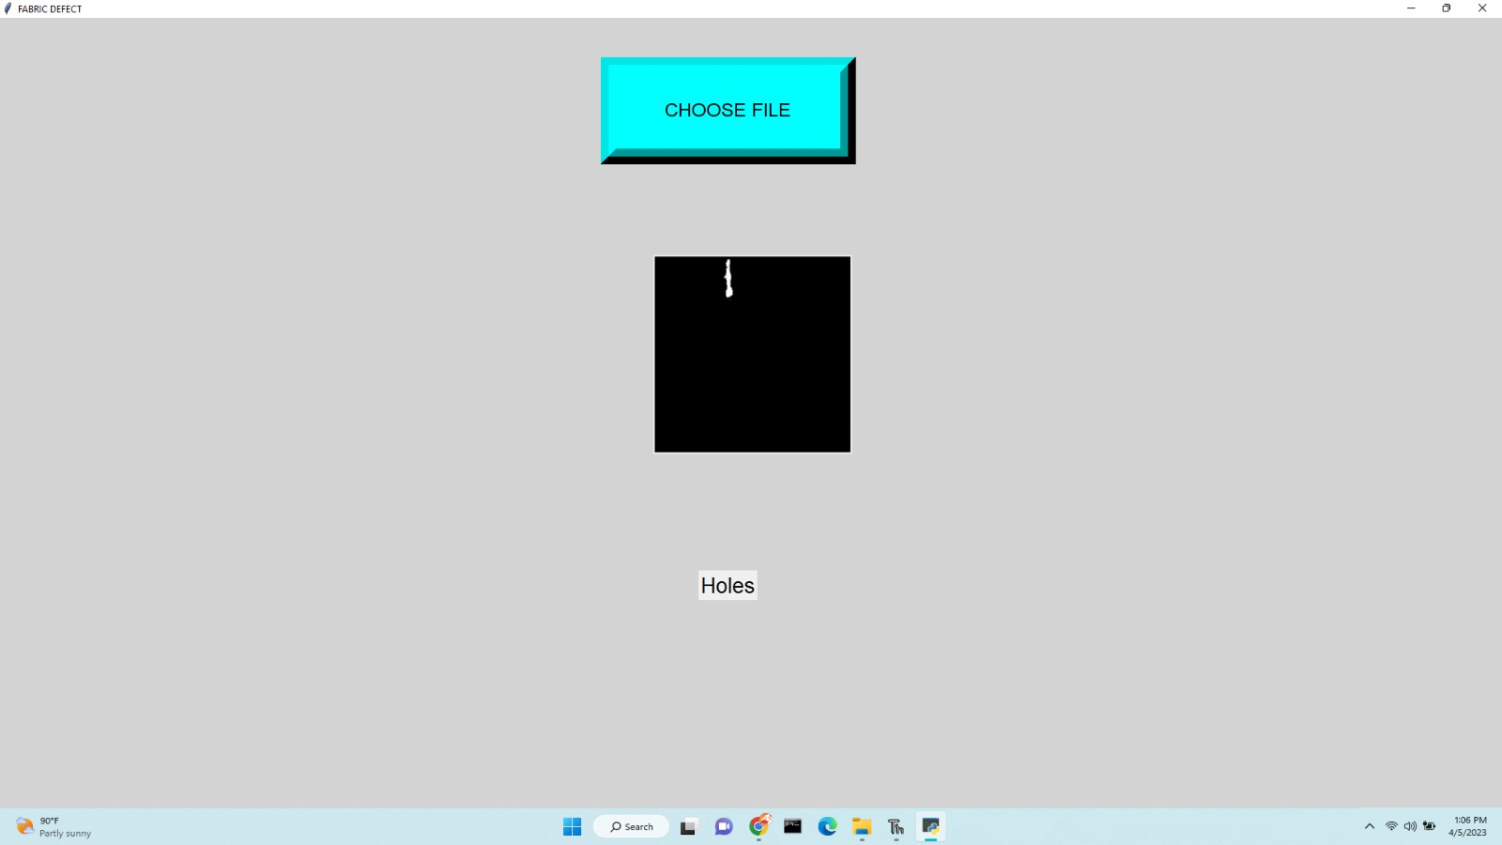
TESTING SELECTION OF DEFECT
Fabric defect : Lines
Fabric defect : Holes

Slide 19
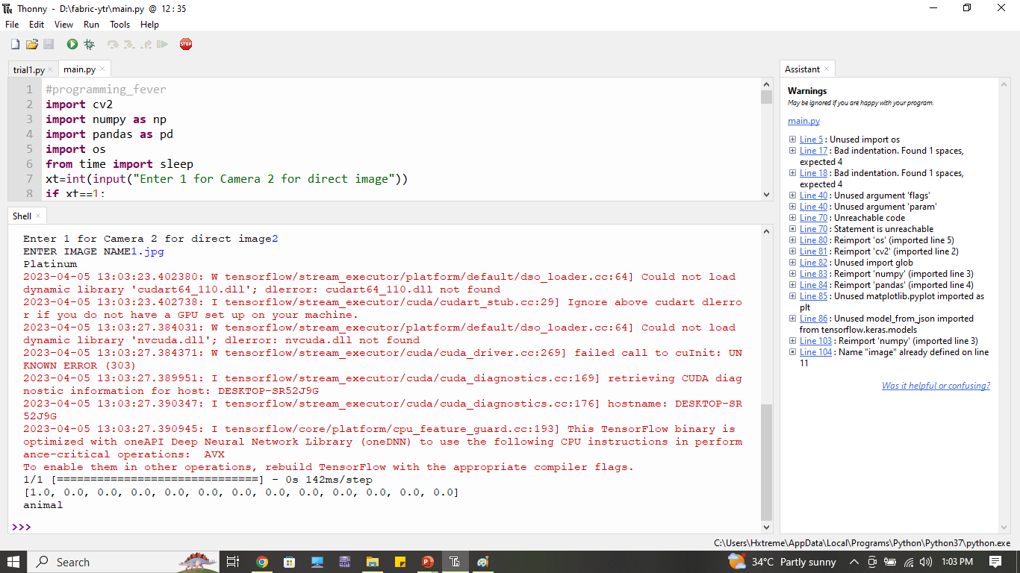
TESTING RESULT OF PATTERN AND COLOR

Slide 20
CONCLUSION
Choosing clothes with different patterns and to find defects are challenging issues for some clothing industries. This system helps industrial machines to identify colours, patterns and defects successfully.

Slide 21
REFERENCES
[1] G Mahmoud M. Khodier, Sabah M. Ahmed, Mohammed Sharaf Sayed. “Complex Pattern Jacquard Fabrics Defect Detection Using Convolutional Neural Networks and Multispectral Imaging”, IEEE Access, 2022.
[2] P.Raguraman et.al, “Color Detection of RGB Images using Python and OpenCV”, International Journal of Scientific Research in Computer Science Engineering and Information Technology, Volume:7, Issue:1, ISSN: 2456-3307, 2021.
[3] ] Diah Harnoni Apriyanti; et.all, “Automated color detection using color labels and deep learning”, National Libarary of Medicine, volume:16, Issue:10, October 2021.

Slide 22
REFERENCES(CONTD….)
[4] Yuri I.Zhuravlev; et.all, “Pattern Recognition and Image Analysis”, Fedral Research Center, Volume:31,Issue:3, July 2021.
[5] Shruti Bharadwaj, Sharath H.K.;et.all- “Pattern and color recognition in CCNY”, IEEE/CVF Conference on Computer Vision and Pattern Recognition SSN-2343733,Volume-2,Issue-5,May 2021.
[6] Lavanya E;et.all, “Recognization of Cloth Pattern and Colour for Blind People”, International Journal of Engineering Research & Technology(IJERT), Volume:9, Issue:05, ISSN:2270-0181,May-2020.

Slide 23
REFERENCES(CONTD…)
[7] Suresh Kumar R; et.all, “An Implementation of Automatic Clothing Pattern and Color Recognition for Visually Impaired People”, International Journal of Applied Engineering Research , Volume:13, Issue: 11 ; Paper number: 8850-8855, November 2020.
[8] Amrita Vishwa Vidyapeetham, et.all- “Color detection in RGB-modeled images using MAT LAB”. International Journal of Engineering & Technology, Volume:7(2):29-33 DOI:10.14419, May 2019.

Slide 24
REFERENCES(CONTD…)
[9] Kumuthini M, Shre Subasine J, Veenaloshini U, Rajeswari D, “Fabric Property And Defect Detection Using Deep Learning Model”, International Conference on Emerging Trends in Industry 4.0 and Sustainable Concepts, February 2023.
[10] Kumuthini M, Shre Subasine J, Veenaloshini U, Rajeswari D, “Fabric Property And Defect Detection Using Deep Learning Model”, IJRASET International Journal for Research in Applied Science & Engineering Technology May 2023.

Slide 25
PUBLICATIONS
S.NO | NAME OF THE AUTHOR | NAME OF THE JOURNAL/CONFERENCE | TITLE OF THE PAPER | STATUS
1. | Kumuthini. M, Shre Subasine. J, Veenaloshini. U, Rajeswari. D | International Journal for Research in Applied Science & Engineering Technology (IJRASET) May 2023 | “Fabric Property and Defect Detection Using Deep Learning Model” | Published
2. | Kumuthini. M, Shre Subasine. J, Veenaloshini. U, Rajeswari. D | International Conference on Emerging Trends in Industry 4.0 and Sustainable Concepts February 2023 | “Fabric Property and Defect Detection Using Deep Learning Model”, Volume 11, Issue V, Page No:409-411, ISSN:2321-9653, www.ijraset.com | Presented

Slide 26
THANK YOU

